Slide 1
Which Antibiotic When?
Brendan Kraus, DVM

Slide 2
Classes of Antibiotics
Beta Lactams
Chloramphenicol Derivatives
Floroquinolones
Macrolides
Sulfonamides
Tetracyclines

Slide 3
Types of Antibiotics
Time Dependent
Area under the Curve
Concentration Dependent
Bacteriocidal
Kills the bacteria
Bacteriostatic
Inhibits the bacteria from replicating allowing the body to kill it.

Slide 4
Terms of Interest
MIC
Minimum Inhibitory Concentration
The level of drug it takes to inhibit or kill a certain bacteria. This is a different level for each bacteria and is unique to the interaction between itself and the drug
Cmax
Maximum concentration of drug level achieved in the body
AUC
The drug level in the body is a bell shaped curve. The area below the curve and above the MIC is the AUC.
Tmax
The amount of time it takes an antibiotic to reach maximum concentration (Cmax)

Slide 5
Drug Level in the body AUC vs Concentration Dependent AB

Slide 6
Where is the Drug?
Drugs have different availabilities (bound up to proteins in the blood or free)
Free drug is the active form
Drugs have different tissue preferences
Some “like” to concentrate in the tissues, fat, blood, etc
Drug may get to a high level in the blood, but can it get to the site of infection?
Some drugs penetrate tissue well and others do not (tissue, abscess, brain, joint,)

Slide 7
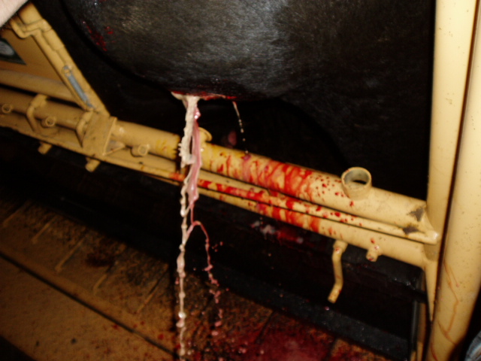
Can’t Get into Pus

Slide 8
Why will my antibiotic work on some sets of calves but not on others
TIMING
How much of a head start to the bacteria have on you
Pneumonia bugs can double in number every hour through replication
In 24 hours, 1 bacteria becomes 16,777,216
Better hope he wasn’t a resistant bug
This is why it becomes important to kill them as completely as possible as quick as possible.

Slide 9
Why will my antibiotic work on some sets of calves but not on others
Host Defenses
Is this calf healthy enough (stress, colostrum, vaccination) to fight back against the bacteria
Differences in bacteria
Bacteria are smart. They are very good at adapting to our antibiotics. Research is trying to find out if they are shifting to resistance once we get them or if they are coming in with resistant bacteria.
What will we be able to do about it??

Slide 10
Why will my antibiotic work on some sets of calves but not on others
Correct Diagnosis?
Your ability to manage a case decreases as the time sick increases
Very early illness, many will recover despite what you do
Very late illness, many will die despite what you do
Your decisions on who to treat and what to use are most important early in the disease process

Slide 11
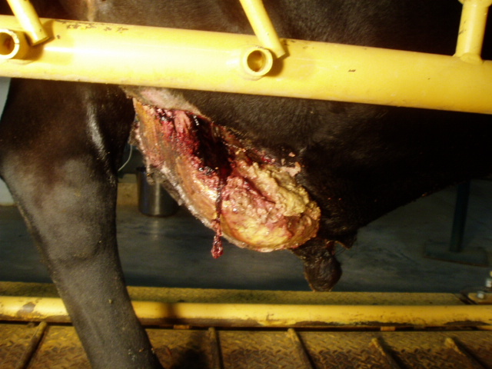
Can’t Get into Dead Tissue

Slide 12
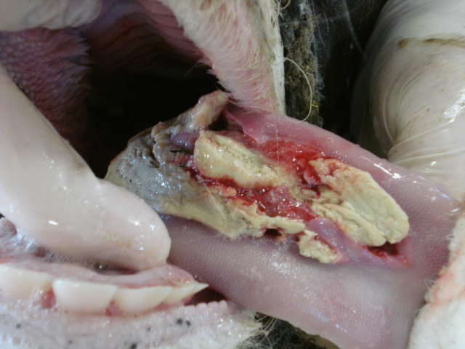
Can’t Get into Dead Tissue

Slide 13
Beta Lactams
Penicillin, Ampicillin, Ceftiofur (Excede,Naxcel, Excenel)
Work on bacteria by rendering them unable to maintain their cell wall which ruptures them
Their “lipid solubility” or ability to penetrate tissues is low
They are Time dependent
A short dose of these drugs is not very effective
Bacteriocidal

Slide 14
What is Penicillin Good For?
Clostridials
The problem is most Clostridials are not caught in time to save the animal
Tetanus
Enterotoxemia (Overeating Disease)
Blackleg

Slide 15
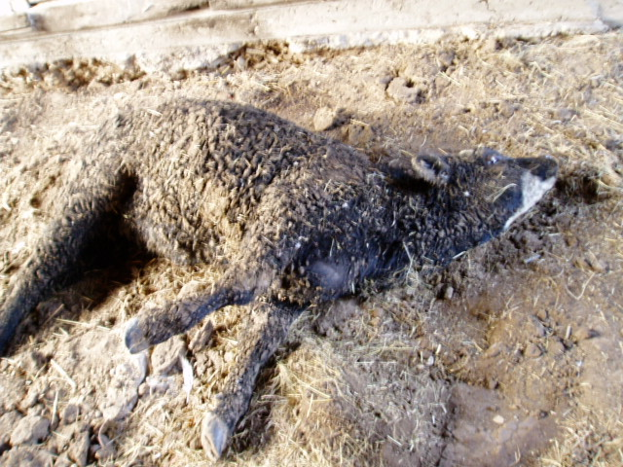

Slide 16
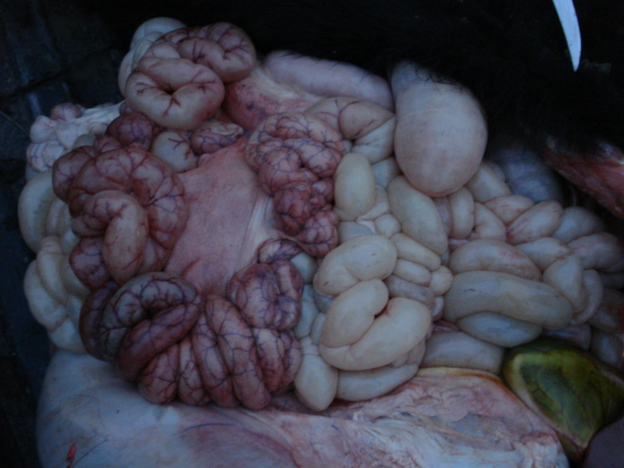

Slide 17
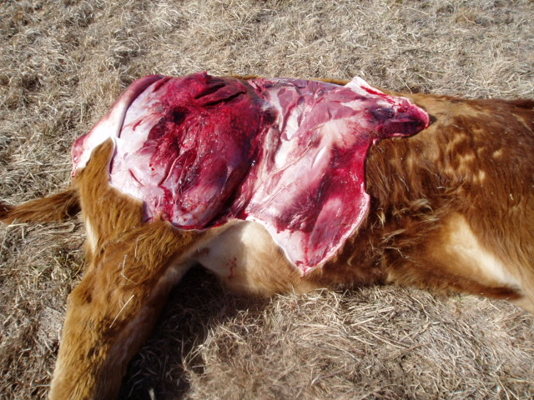

Slide 18
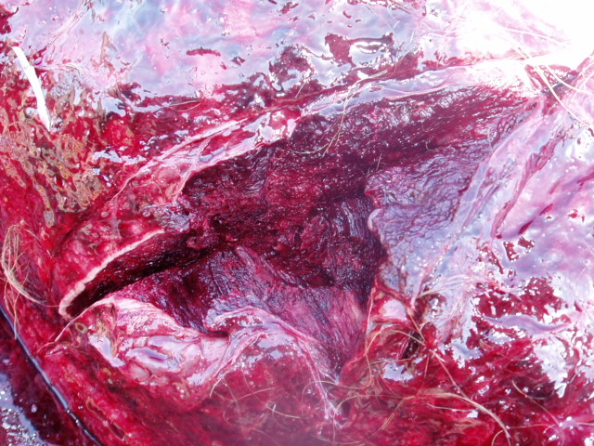

Slide 19
Chloramphenicol Derivatives
Florfenicol (Nuflor)
Interferes with protein synthesis. Clogs up the machinery that the cell uses to build proteins which will not allow it to replicate
Has good ability to penetrate tissue
Chloramphenicol is a great drug but has human health implications
Time Dependent
Bacteriostatic

Slide 20
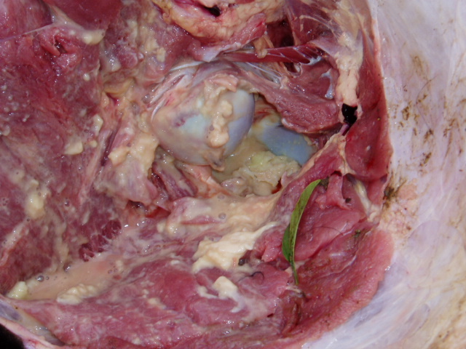
Can’t Get into Abscessed Joints

Slide 21
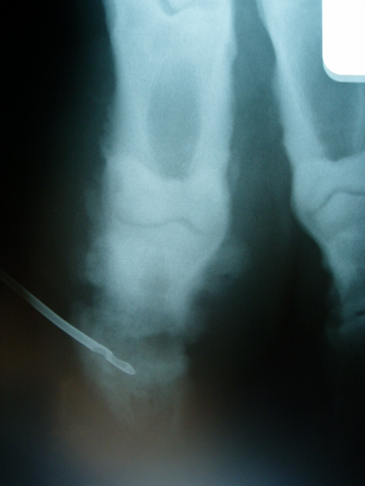

Slide 22
Fluroquinolones
Enrofloxacin (Baytril), Danofloxacin (Advocin)
Does not allow the bacteria to replicate DNA-interferes with DNA coiling
This class drugs are used a lot in the human health field so their use is restricted.
It is illegal to use these drugs for any condition other than what is on the label
Good Tissue Penetration
Concentration Dependent
Bacteriocidal

Slide 23
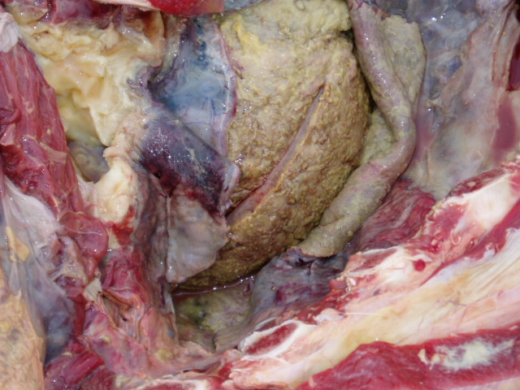
Can’t Get into Fibrin in Heart Sac

Slide 24
Macrolides
Tilmicosin (Micotil), Tulathromycin (Draxxin), Tildipirosin (Zuprevo), Gamithromycin (Zactran)
Interferes with protein synthesis
Good tissue penetration
Seem to be good drugs for pneumonia in animals and people. The last 3 new pneumonia drugs were from this class.
Long lasting because it has an affinity for the lung
Micotil is bacteriostatic. Draxxin and Zactran claim to be both. This has to do with the dose.

Slide 25
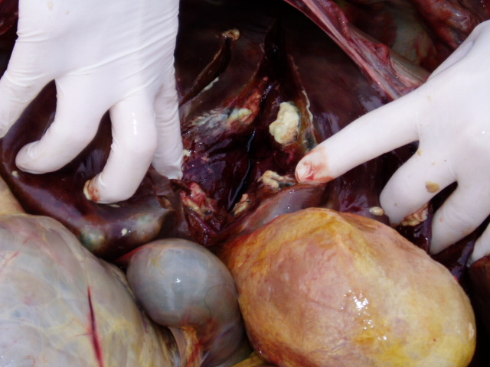
Can’t Get into Mature Liver Absceses

Slide 26
Sulfonamides
Sulfa boluses
Do not allow bacteria to make folic acid which they need to survive
Time dependent
Poor tissue penetration
I pretty much only find use for this for treating gastrointestinal issues (cocci, calf scours) as there are better choices for other conditions
Bacteriostatic

Slide 27
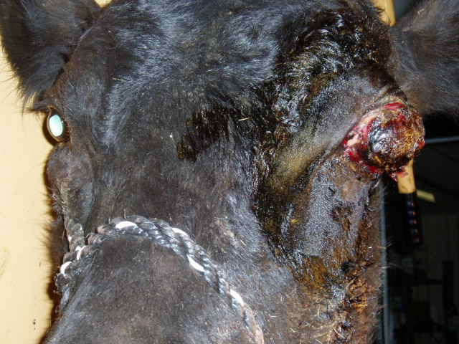
Can’t Cure Cancer

Slide 28
Tetracyclines
Oxytetracycline, CTC (feed)
Interferes with protein synthesis
Medium/good tissue penetration
Time dependent
Cheap, all-around antibiotic. Not good for pneumonia. Mainly for pinkeye, footrot, misc.
Bacteriostatic
Coming Soon-Veterinary Feed Directive

Slide 29
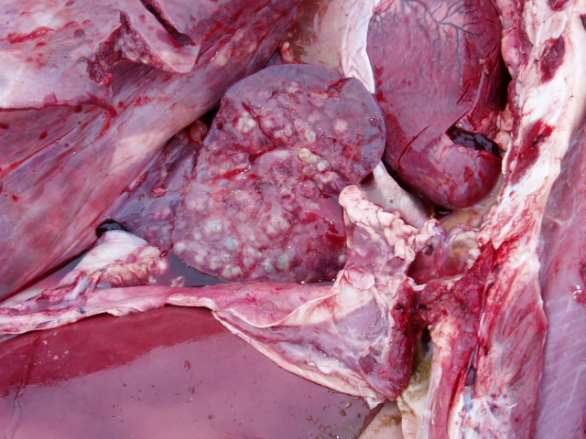
Can’t Get in this Lung

Slide 30
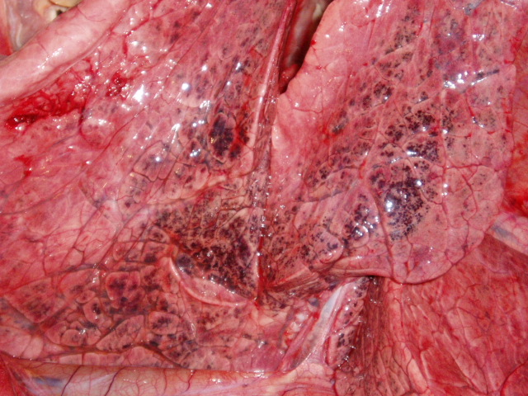
But Can Get in this Lung!!

Slide 31
Avoiding Antibiotic Residues
Identify all animals treated
Record treatments: Date, ID, Dose given, rout of administration, person administering, withdrawal
Follow the labels
Select short withdrawals
Never give more than 10mL per injection
Avoid using multiple antibiotics
Don’t mix AB in same syringe
Avoid Extra Label Drug Use
Check treatment/med records prior to marketing
There is no off label use of feed medication!!!

Slide 32
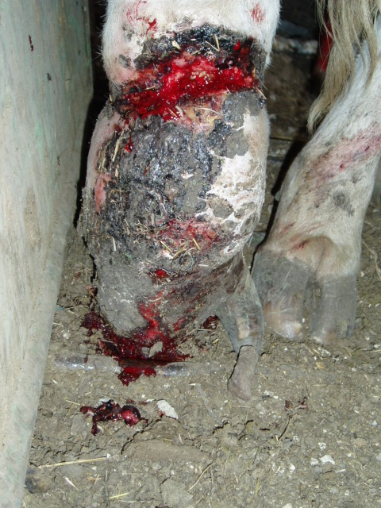
Seriously??
Why Even Try

Slide 33
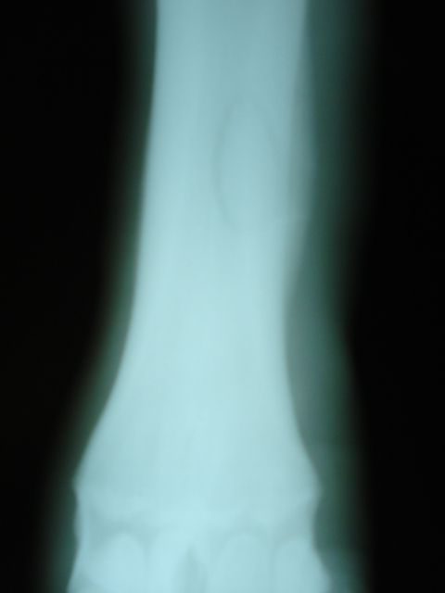

Slide 34
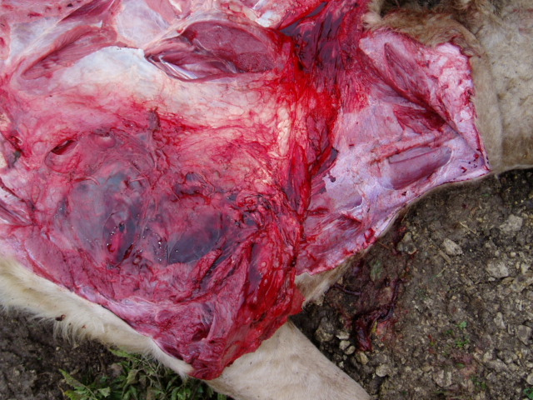
Antibiotics can make them sore

Slide 35
Antibiotic Success
Get a correct diagnosis
Get to the animal early in the disease process
Pick an antibiotic which has effect against the disease you are treating
Treat surgically if needed to remove dead tissue
Treat long enough to succeed

Slide 36
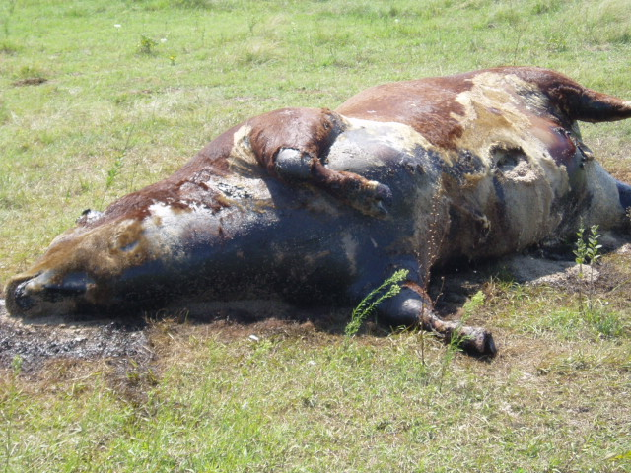
Get There Early Enough to
Make a Difference

Slide 37
Questions??

