Slide 1
Bullers: What’s the Big Deal
Brendan Kraus, DVM

Slide 2
What is Bulling?
Buller steer syndrome is a behavioral problem among feedlot cattle that is characterized by repeated mounting of a steer (buller) by a group of steers (riders)

Slide 3
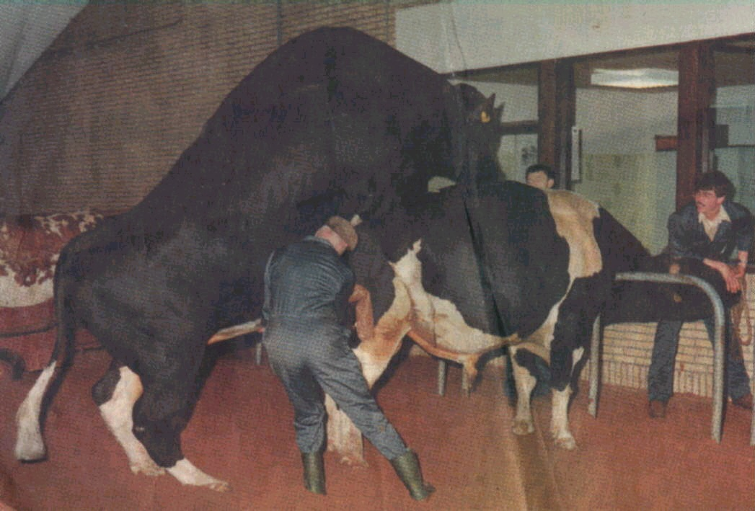

Slide 4
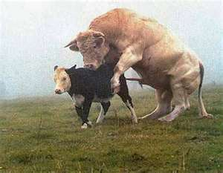
How to create a C-Section

Slide 5
Is Bulling a Problem?
Buller steer syndrome ranks as one of the top 3 health problems in the industry behind respiratory and foot rot.

Slide 6
Problems from Bulling
Exhaustion
Hair Loss
Swelling and trauma to rump and tail head
Broken Bones
2.5 x more likely to become sick/chronic
Death

Slide 7
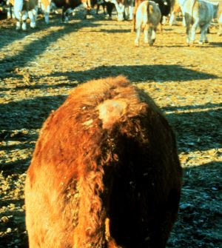

Slide 8
What is the Cost?
The cost of a buller was estimated to be around $50/animal.(study 20 years old)
There is an average of 2-4% bullers across the yard. (Pen range from 0-11%
At Tiffany Cattle Co, this equates to a $10,000 loss of productivity per year (.01x$35)

Slide 9
Where are the losses?
Labor to remove bullers
Weight loss
Injuries
Deaths
Extra Pen Facility to handle

Slide 10
What Causes Bullers?
Many factors have been implicated
Anabolic steroids
Improper Implant technique
Reimplant
Changes in weather/season
Excessive Mud
Dusty Conditions

Slide 11
What Causes Bullers?
Entry Weights
Bullers can be the heavier animal
Disease (pneumonia, water belly, coccidiosis)
Group Size (adjacent heifer pen)
Improper/Late Castration
Feeding Mgmt.(moldy feed,green chop/alfalfa,ration change, feeding routine, bunk managment
Transporation
Handling
Mixing
Social Dominance Behavior

Slide 12
So Which Is It?
No single answer has been found
There is evidence that the use of anabolic agents contribute to the development of bullers
Due in part to the rising number of bullers as DES levels were increased in the 70’s.
However, this study may have been confounded because during the time this was looked at, feedlots were rapidly increasing the number of cattle on feed and number per pen.

Slide 13
Pen Dynamics
In one study, the number of bullers tended to increase as the numbers of animals in the pen increased
Commingled sources
Addition of new animal/animals
Regrouping of animals that have been together
Heavier incoming groups tend to have more bullers

Slide 14
What Makes the Buller Attractive?
There has been a documented increase in the urinary estrogen and testosterone levels in buller steers
Possible that they smell different
However, this may be due to stress as the levels will drop to normal 3-4 days after being isolated
Addition of unfamiliar animals
Animals with different colored coats
Visual Stance of the Buller

Slide 15
Final Take on What Causes Bullers
Probably related to the establisment of social hierarchies among unfamiliar animals
Higher in comingled groups or groups that have been brought in from the range
We don’t know if bullers are at the top or bottom of the pecking order
Implants may aggravate the problem
Steers can be come more aggressive and bull-like in behavior

Slide 16
How Can We Prevent Bullers?
Create pen assignments based on as few groups as possible
Reduce number of animals in the pen
Close management of ration and feeding
Maximize Correct Implants
Arrival Implant vs delayed
Frequent Pen Checks
Won’t reduce number but used to ID and remove bullers quickly

Slide 17
How Do We Treat Bullers?
Remove from the pen quickly
You may group bullers together in a separate pen, but do not exceed 50 animals.
Upon removal from the home pen, check the buller for fever and treat with antimicrobial if feverish
Check the implant for bunched, abscessed, or missing implant ant rectify
Return Buller to home pen after he has recovered, however up to 1/3 will need to be pulled out again, so monitor them at home
A good time to try to return bullers is at reimplant

Slide 18
Proper Implanting
Defective Implant
Abscess
Expelled implant
Cartilage Embedment
Crushed Pellets
Missing Pellets
Bunched Pellets

Slide 19
Location
Middle third on the backside of the ear
Must be SubQ
Avoid blood vessles
-Not near the base of the ear

Slide 20
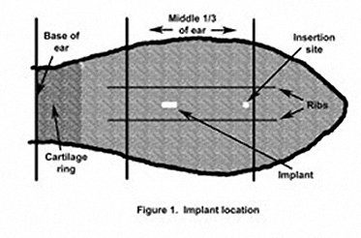

Slide 21
Economic Loss
Misplaced implants have been shown to cause a .17lb/day reduction in carcass gain. This equates to 20lb on a 120 feed period or $25 lost!
Picture each implant as your client’s $20 bill before you put it in.

Slide 22
Technique
Gun and implant tray should be cleaned prior to use
Use chlorhexidine diluted 1oz per gallon for disinfection of needle (measure it)
Stronger solutions can cause irritation and expulsion of pellet
Weaker solutions may not disinfect
Disinfect needle between every calf

Slide 23
Technique
Store implants strips that are open in a sealed container in the refrigerator.
If the ear is dirty, scrub clean with a brush and bucket of disinfectant
If the ear is wet, dry it
Palpate the implant after installation to ensure it is subQ and press the needle hole closed

Slide 24
Quality Control
Check the implant site and the implant itself on every sick animal that comes into the hospital and notify the crew if problems are detected
Check the previous sites of implants during a re-implant and keep track of % problems.

Slide 25
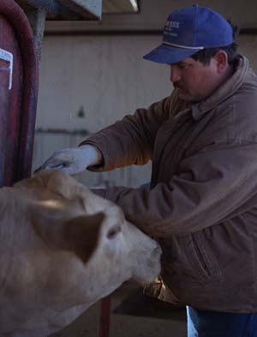
The End

